Slide 1
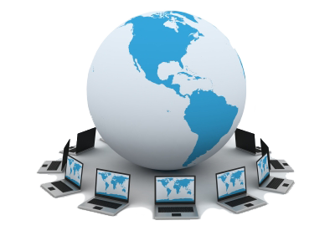
Networking Fundamentals
ITI

Slide 2
Lecture 5 Network Security
Introduction
Security Goals
Security Terminologies
Threats
Attack Methods
Security Policy
Firewalls

Slide 3
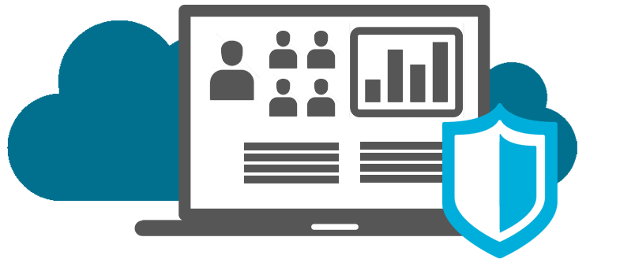
Introduction
People use networks to exchange sensitive information with each other.
People purchase products and do their banking over the Internet.
We rely on networks to be secure and to protect our identities and our private information
Network Security is a shared responsibility that each person must accept when they connect to the network.
Notes:
Objective: to learn about the threats that exist on the network and how we can do our part to protect our computers and information.

Slide 4
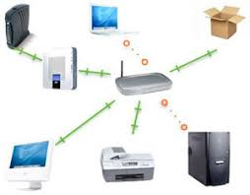
Defining Network Security
Network security is the implementation of security devices, policies, and processes to prevent the unauthorized access to network resources or the alteration or destruction of resources or data.
Security involves protecting resources:
End-user resources
Network resources
Server resources
Information storage resources
Notes:
End-user resources: client workstations
Network resources: Routers, switches, hubs
Server resources: WWW, Email, FTP servers
Information storage resources: Database servers

Slide 5
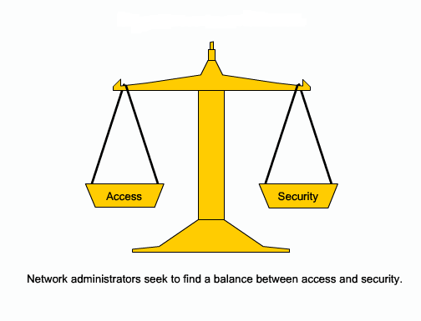
Balancing Business Need with Security Requirement
Notes:
Balancing Business Need with Security Requirement
There is a trade-off between a completely secure network and the needs of business.
The only way to completely secure a computer is to physically disconnect it from the network and perhaps lock it in a secure area.
This solution would greatly reduce your ability to use whatever resources were to be shared on that system.
The goal is to identify the risks and make an informed decision about how to address them.

Slide 6
What are Security Goals?
Security goals can be defined:
Depending on the application environment
Technical
Security Goals are also called Security Objectives

Slide 7
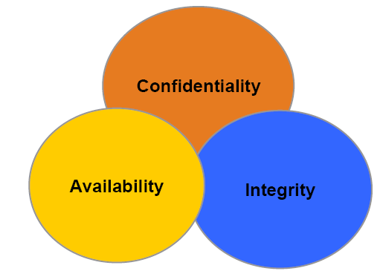
Security Goals Technically Defined

Slide 8
Security Goals Technically Defined
Confidentiality
Ensuring that information is not revealed to unauthorized persons
Data transmitted or stored should only be revealed to an intended audience
Integrity
Ensuring consistency of data
It should be possible to detect any modification of data
Availability
Ensuring that legitimate users are not denied access to information and resources

Slide 9
Security goals in different environments
Banking
Electronic trading
Pharmaceuticals
Corporate / Private Networks
Notes:
Prioritizing the CIA

Slide 10
Security goals in different environments
Banking
Protect against fraudulent or accidental modification of transactions
Protect PINs from disclosure
Ensure customers privacy
Electronic trading
Assure source and integrity of transactions
Protect corporate privacy
Provide legally binding electronic signatures on transactions

Slide 11
Security goals in different environments
Pharmaceuticals
Protect corporate / individual privacy
Confidentiality is most critical
All Networks
Prevent outside penetrations (who wants hackers?)

Slide 12
Security Terminologies
Assets
Threat
Vulnerability
Risk
Exploits
Impacts
Notes:
Exploits = الاستغلال
Assets
Everything that have value for an organization or impact its business continuity.
This includes personals, hardware, software, physical devices and documents. These assets should be identified to create information security system.
Threat
A person, thing, event or idea which poses danger to an asset in terms of that asset’s confidentiality, integrity, availability or legitimate use.
A possible means by which a security policy may be breached (e.g. loss of integrity or confidentiality).
Vulnerability
Weakness or absence of safeguards
Risk
A measure of the cost of realized vulnerability
The risk is high when
The value of a vulnerable asset is high
The probability of successful attack is high
Exploits
An exploit is a program, script or code that is aimed to perform unauthorized operations.
An example is a backdoor Trojan used to grant unauthorized access to a machine.
Impacts
They are the result of an exploited vulnerability
Example: deleted files, loss information, loss company image or loss privacy information.

Slide 13
Focus of Security is Risk
Security deals with managing risk to your critical assets
Security is basically an exercise in loss reduction
It's impossible to totally eliminate risk
Risk is the probability of a threat crossing or touching a vulnerability
Risk = Threat x Vulnerabilities

Slide 14
Threats
Accidental
Intentional
Passive
Active
Notes:
Accidental threats: Natural disasters
Intentional threats:
Passive threats: do not modify information contained in the systems or the system state
Active threats: Alteration of information or change the system state

Slide 15
Network Threats
Risks of Network Intrusion
Sources of Network Intrusion
Social Engineering and Phishing

Slide 16
Risks of Network Intrusion
Information Theft
Breaking into a computer to obtain confidential information. Information can be used or sold for various purposes.
Data Loss and Manipulation
Breaking onto a computer to destroy or alter data records.
Notes:
مخاطر اقتحام الشبكة
Example: sending a virus that reformats a computer’s hard drive, or changing information such as the price of an item/

Slide 17
Risks of Network Intrusion
Identity Theft
Personal Information is stolen for the purpose of taking over someone’s identity. Using this information anyone can obtain legal documents, apply for credits and make unauthorized online activities.
Disruption of Service
Preventing legitimate users from accessing services to which they should be entitled.
Notes:
Disruption اضطراب

Slide 18
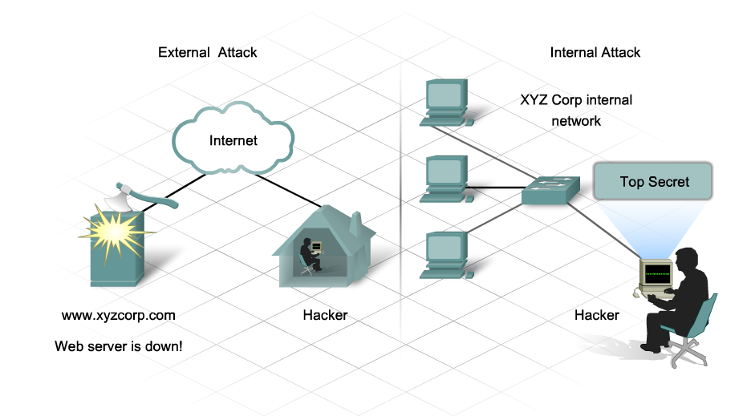
Sources of Network Intrusion

Slide 19
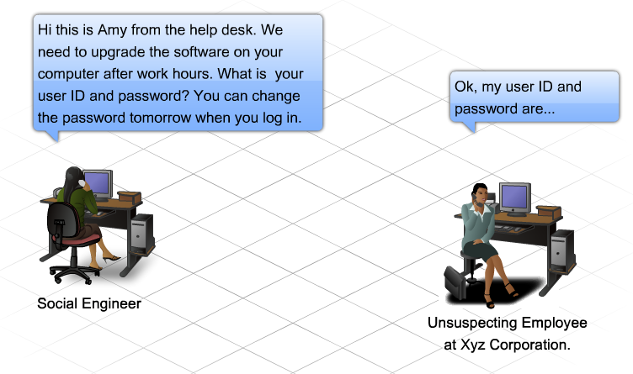
Social Engineering
Social engineering is a term that refers to the ability of something or someone to influence the behavior of a group of people.
Notes:
In the context of computer and network security Social Engineering refers to a collection of techniques used to deceive internal users into performing specific actions or revealing confidential information.

Slide 20
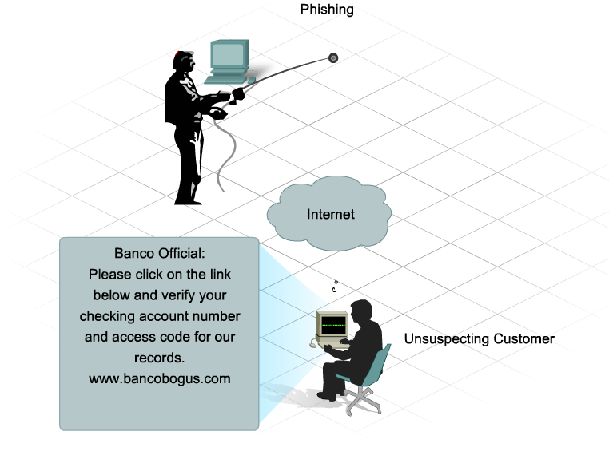
Phishing
Phishing is a form of social engineering where the phisher pretends to represent a legitimate outside organization.
Notes:
The phisher typically contact the target individual (the phishee) via email.
The phisher might ask for verification of information, such as passwords or usernames in order prevent some terrible consequence from occurring.

Slide 21
DEFCON

Slide 22
Methods of Attack
Viruses, Worms and Trojan Horses
Denial of Service and Brute Force attacks
Spyware, Tracking Cookies, Adware and Pop-ups
Spam

Slide 23
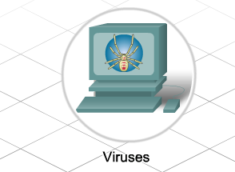
Viruses, Worms and Trojan Horses
Viruses
A virus is a program that runs and spreads by modifying other programs or files. A virus cannot start by itself; it needs to be activated. Once activated, a virus may do nothing more than replicate itself and spread.

Slide 24
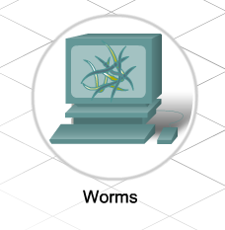
Viruses, Worms and Trojan Horses
Worms
A worm is similar to a virus, but unlike a virus does not need to attach itself to an existing program. A worm uses the network to send copies of itself to any connected hosts. Worms can run independently and spread quickly. They do not necessarily require activation or human intervention

Slide 25
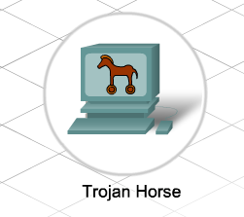
Viruses, Worms and Trojan Horses
Trojan Horses
A non-self replicating program that is written to appear like a legitimate program, when in fact it is an attack tool.
Relies upon its legitimate appearance to deceive the victim into initiating the program. It may be relatively harmless or can contain code that can damage the contents of the computer's hard drive.
Trojans can also create a back door into a system allowing hackers to gain access.

Slide 26
Denial of Service
Denial of Service (DoS)
DoS attacks are aggressive attacks on an individual computer or groups of computers with the intent to deny services to intended users. DoS attacks can target end user systems, servers, routers, and network links.
Notes:
In general, DoS attacks seek to:
Flood a system or network with traffic to prevent legitimate network traffic from flowing
Disrupt connections between a client and server to prevent access to a service

Slide 27
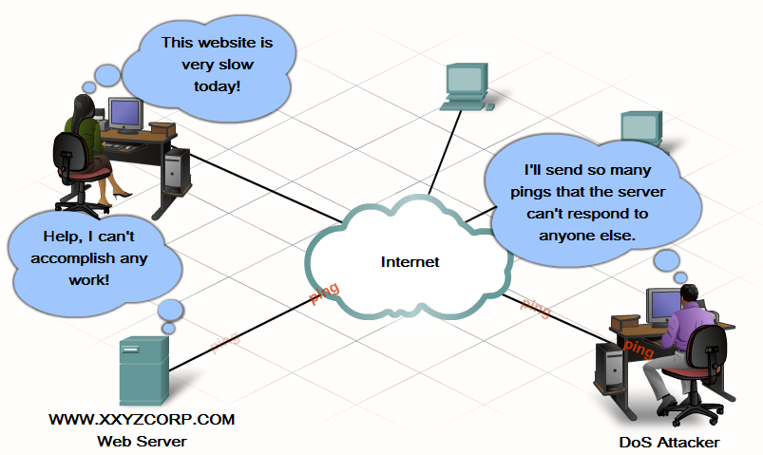
Denial of Service Example
3
1
2

Slide 28
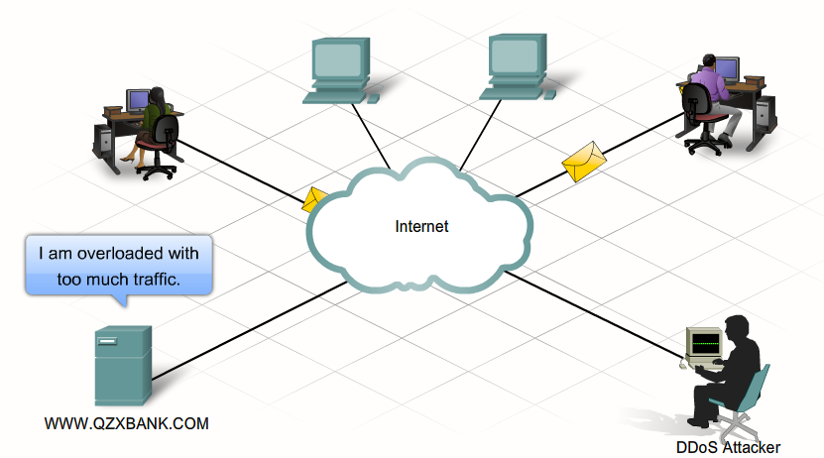
Distributed Denial of Service
Distributed Denial of Service (DDoS)
DDoS is a more sophisticated and potentially damaging form of the DoS attack. It is designed to saturate and overwhelm network links with useless data.
Notes:
DDoS operates on a much larger scale than DoS attacks.

Slide 29
Brute Force Attacks
With brute force attacks, a fast computer is used to try to guess passwords.
The attacker tries a large number of possibilities in rapid succession to gain access or crack the code. Brute force attacks can cause a denial of service due to excessive traffic to a specific resource or by locking out user accounts.

Slide 30
Spyware and Tracking Cookies
Spyware
Spyware is any program that gathers personal information from your computer without your permission or knowledge. This information is sent to advertisers or others on the Internet and can include passwords and account numbers.
Tracking Cookies
Cookies are a form of spyware but are not always bad. They are used to record information about an Internet user when they visit websites.

Slide 31
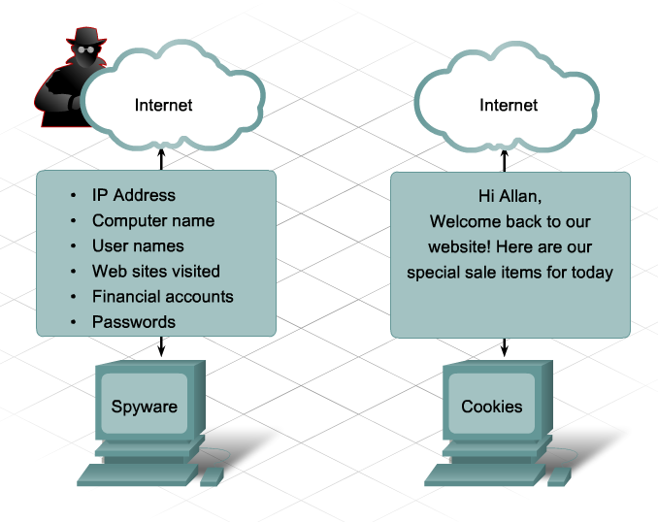

Slide 32
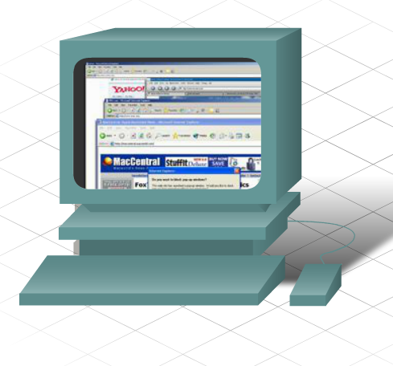
Spyware and Tracking Cookies
Adware
Adware is a form of spyware used to collect information about a user based on websites the user visits. That information is then used for targeted advertising. Adware is commonly installed by a user in exchange for a "free" product.
Pop-ups
Pop-ups are additional advertising windows that display when visiting a web site. Unlike Adware, pop-ups are not intended to collect information about the user and are typically associated only with the web-site being visited.

Slide 33
Spam
Spam is a serious network threat that can overload ISPs, email servers and individual end-user systems. A person or organization responsible for sending spam is called a spammer. Spammers often make use of unsecured email servers to forward email. Spammers can use hacking techniques, such as viruses, worms and Trojan horses to take control of home computers.

Slide 34
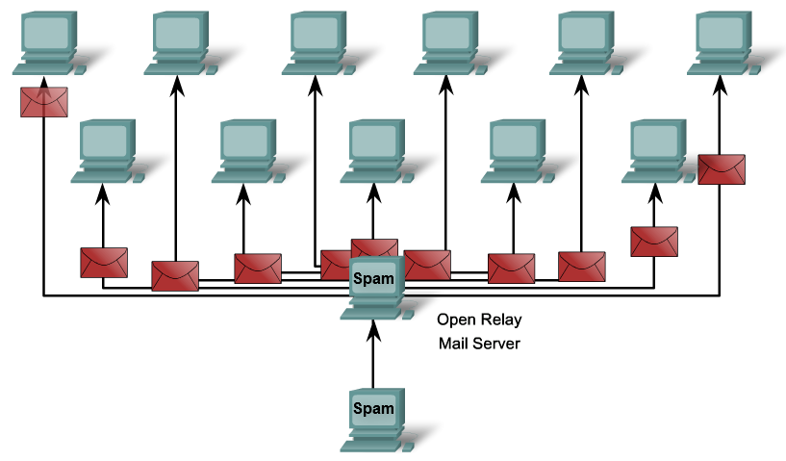

Slide 35
Common Security Measures
Security risks cannot be eliminated or prevented completely. However, effective risk management and assessment can significantly minimize the existing security risks.
True network security comes from a combination of products and services, combined with a thorough Security Policy and a commitment to adhere to that policy.

Slide 36
Common Security Measures
Security Policy
Updates and Patches
Anti-virus Software
Anti-Spam
Anti-Spyware
Notes:
تدابير امنية مشتركة

Slide 37
Common Security Measures
A Security Policy is a formal statement of the rules that users must adhere to when accessing technology and information assets.
It can be as simple as an acceptable use policy, or can be several hundred pages in length, and detail every aspect of user connectivity and network usage procedures.

Slide 38
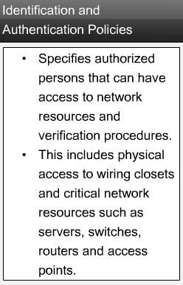
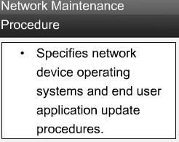
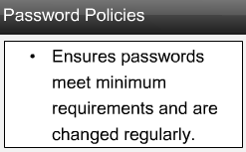
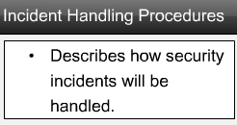
Security Policy

Slide 39
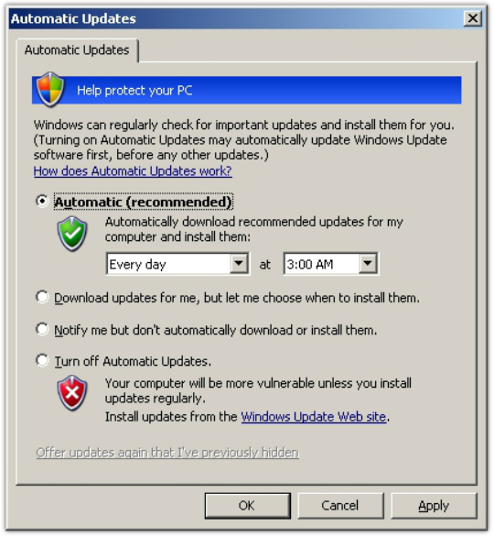
Patches and Updates
A patch is a small piece of code that fixes a specific problem.
An update, on the other hand, may include additional functionality to the software package as well as patches for specific issues.

Slide 40
Anti-Virus Software
Anti-virus Software
Anti-virus software can be used as both a preventative tool and as a reactive tool. It prevents infection and detects, and removes, viruses, worms and Trojan horses. Anti-virus software should be installed on all computers connected to the network.

Slide 41
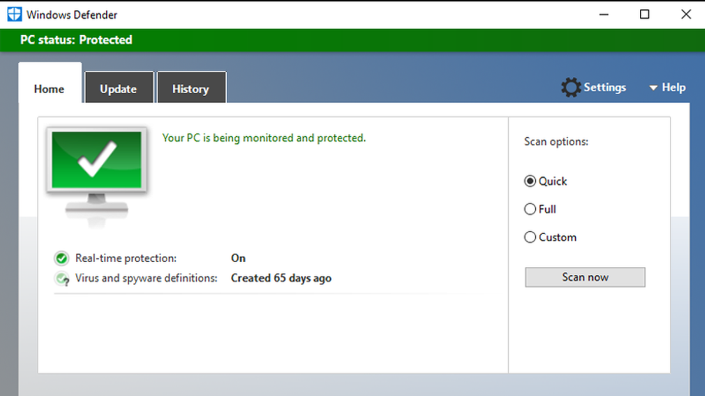



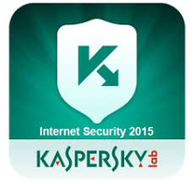
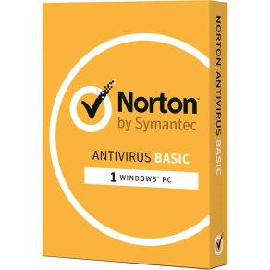

Anti-virus Software

Slide 42
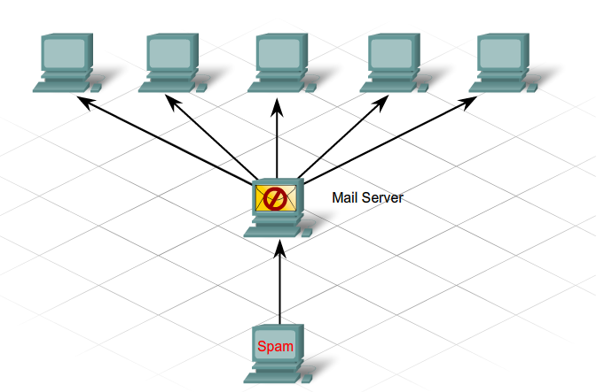
Anti-Spam
Anti-spam software protects hosts by identifying spam and performing an action, such as placing it into a junk folder or deleting it. It can be loaded on a machine locally, but can also be loaded on email servers.

Slide 43
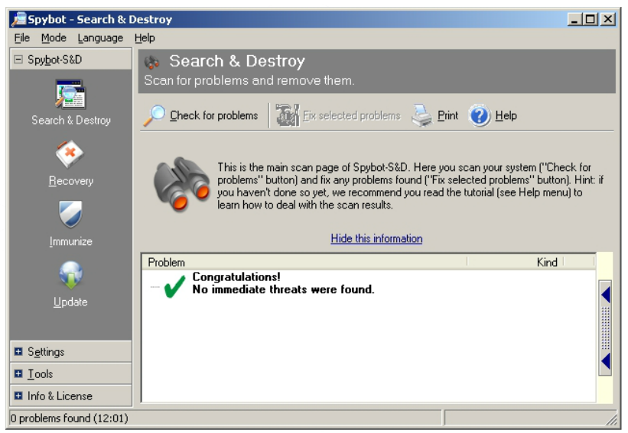
Anti-Spyware
Anti-spyware software detects and deletes spyware applications, as well as prevents future installations from occurring. Many Anti-Spyware applications also include detection and deletion of cookies and adware.
Pop-up stopper software can be installed to prevent pop-ups.
Notes:
Many web browsers include a pop-up blocker feature by default. Note that some programs and web pages create necessary and desirable pop-ups.

Slide 44
Using Firewalls
What is a Firewall?
Using a Firewall
Best Practices

Slide 45
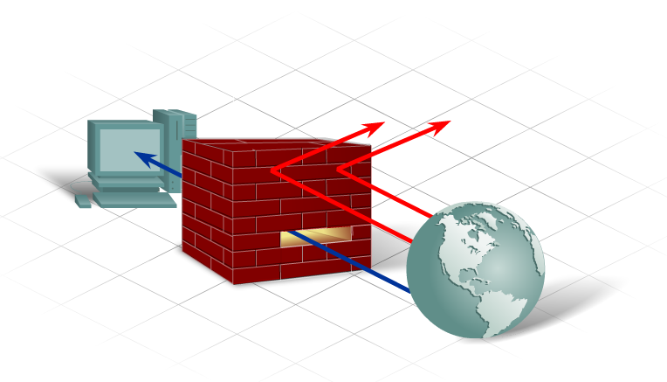
What is a Firewall?
A Firewall is one of the most effective security tools available for protecting internal network users from external threats.
A firewall resides between two or more networks and controls the traffic between them as well as helps prevent unauthorized access.

Slide 46
What is a Firewall?
Packet Filtering - Prevents or allows access based on IP or MAC addresses.
Application / Web Site Filtering - Prevents or allows access based on the application. Websites can be blocked by specifying a website URL address or keywords.
Stateful Packet Inspection (SPI) - Incoming packets must be legitimate responses to requests from internal hosts. Unsolicited packets are blocked unless permitted specifically. SPI can also include the capability to recognize and filter out specific types of attacks such as DoS.

Slide 47
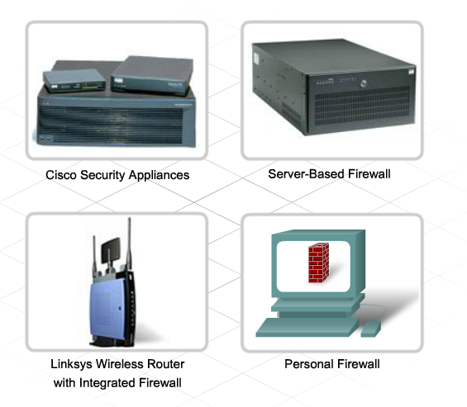
What is a Firewall?
Firewall products come packaged in various forms:

Slide 48
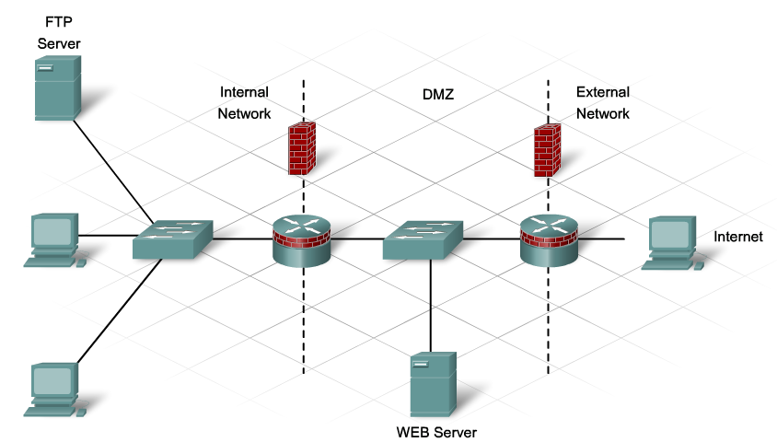
Using a Firewall

Slide 49
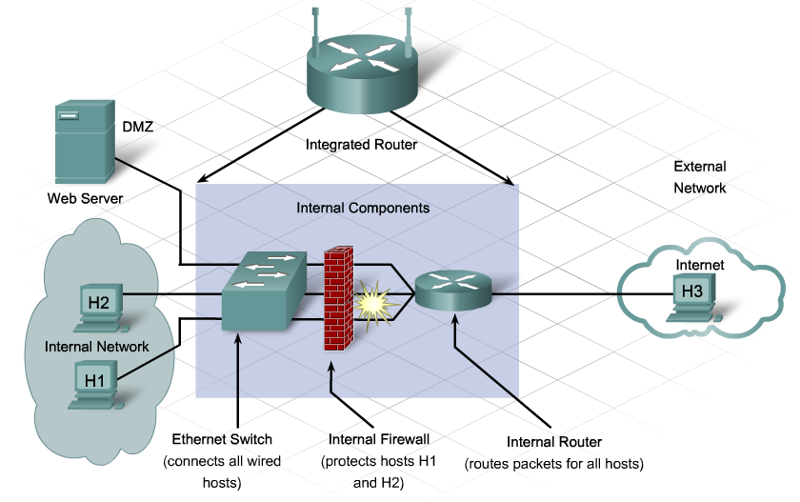
Using a Firewall
Notes:
demilitarized zone

Slide 50
Mistakes People Make that Lead to Security Breaches
The SANS Institute's lists of silly things people do that enable attackers to succeed.
The Four Worst Security Mistakes End Users Make
The Six Worst Security Mistakes Senior Executives Make
The Eight Worst Security Mistakes Information Technology People Make

Slide 51
The Worst Security Mistakes End Users Make
Failing to install anti-virus, keep its signatures up to date, and apply it to all files.
Opening e-mail attachments without verifying their source and checking their content first, or executing games or screen savers or other programs from un-trusted sources.
Failing to install security patches especially for Microsoft Office, Microsoft Internet Explorer, and Netscape.
Not making and testing backups.

Slide 52
The Worst Security Mistakes Senior Executives Make
Assigning untrained people to maintain security and providing neither the training nor the time to make it possible to learn and do the job.
Failing to understand the relationship of information security to the business problem-they understand physical security but do not see the consequences of poor information security.
Relying primarily on a firewall.
Failing to realize how much money their information and organizational reputations are worth.
Authorizing short-term fixes so problems re-emerge rapidly.
Pretending the problem will go away if they ignore it.

Slide 53
The Worst Security Mistakes IT People Make
Connecting systems to the Internet before hardening them.
Failing to update systems when security holes are found.
Using telnet and other unencrypted protocols for managing systems, routers, firewalls.
Failing to maintain and test backups.
Running unnecessary services, especially ftpd, telnetd
Implementing firewalls with rules that don't stop malicious or dangerous traffic-incoming or outgoing.
Failing to implement or update virus detection software
Failing to educate users on what to look for and what to do when they see a potential security problem.

Slide 54
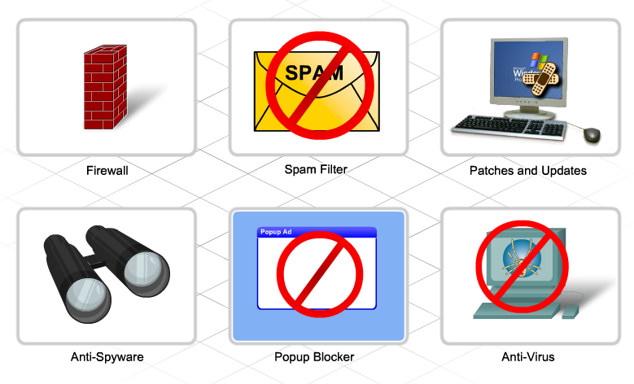
Best Practices
Define security policies
Physically secure servers and network equipment
Set login and file access permissions
Update OS and applications
Change permissive default settings
Run anti-virus and anti-spyware
Update antivirus software files
Activate browser tools –
Popup stoppers, anti-phishing, plug-in monitors
Use a firewall

Slide 55
Thank you

